Slide 1

FUNDAMENTAL OF MANAGEMENT (MG-302)
DELHI TECHNOLOGICAL UNIVERSITY(DTU)
CASE STUDY ON RELIANCE INDUSTRY
Submitted by:
Ashish Kumar - (2K18/SE/041) Gaurav Kumar - (2K18/SE/060)
Submitted to :
Mr. Saurabh Agrawal

Slide 2


Reliance Industries Limited
Overview
Reliance Industries Limited (RIL) is an Indian multinational company headquartered in Mumbai, India. Reliance owns various businesses across India engaged in energy, petrochemicals, textiles, natural resources, retail, and telecommunications. Reliance Industry is the largest company of India by market capitalization and revenue (around 6.59 lakh crores INR in 2020).
In the year 1966 the RIL was founded by Shri Dhirubhai H.Ambani, it was started as a small textile manufacturer unit. In May 8 1973, Dhirubhai Ambani changed the name of Reliance Commercial Corporation to Reliance Industries Limited (RIL).
Some Facts and figures of reliance industries:
Reliance Industries is India's largest private sector company in all major financial parameters. It is also the most profitable company in India. Reliance is the biggest exporter of India who contributes 8% of the total export value of India. Reliance Industry exports its goods to 108 countries. Reliance Industry ranks 106 in the fortune 500 list and 8th in the Top 250 Global Energy company. It is also the highest income tax payer in India. Reliance Industries is the first Indian company who has exceeded the market capitalization of $100 Billion. In fiscal year 2020, Reliance Industries Limited contributed over 1.15 trillion Indian rupees to India's national exchequer.

Slide 3
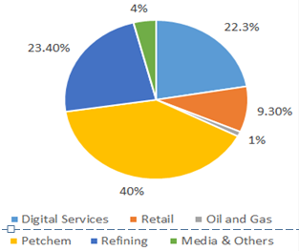
Business Model of Reliance Industry
Reliance Industry runs several businesses and every business has its own business and revenue
model.
Here we listed some major businesses of Reliance Industry.
Refining Business: Reliance’s core business is refining business. Reliance buys crude oil from overseas markets and then refine them in their refineries and produce petroleum products. After the Refining, Reliance sells these petroleum products in the Indian and overseas market. Most of the revenue of Reliance Industry comes from Refined petroleum products.
Petrochemicals: Reliance’s second major business is Petrochemicals and the second major source of its revenue is petrochemical.
Reliance Retail: Meanwhile, Reliance Retail is another core business of the reliance industry and founded in 2006. Also, it is the first Indian retail company whose revenue is more than 100000 crore. Reliance owns a retail chain under the brand name of Reliance fresh where they sell Reliance and other company’s products.
Reliance Jio: The other core business of reliance is Jio which is India’s no. 1 telecommunication brand. Jio makes profit by selling tariff plans in large volumes. This is the strategy that makes reliance Industry such a big company. Jio is the company which is owned by the Reliance industries. Jio is a digital service and it provides various E-services like JioTV, JioMeet, JioSaavn, Jiocinema etc.
Other Sources: There is a lot of another source where the revenue of reliance industries come from. Reliance Industry owns Network 18 Group which is a media company. Reliance also owns Mumbai Indian which is an IPL Franchises Team. So there are a lot of sources that contribute to the revenue of Reliance Industry.
Fig. Pie chart showing revenue distribution of Reliance Industries for FY 2020

Slide 4
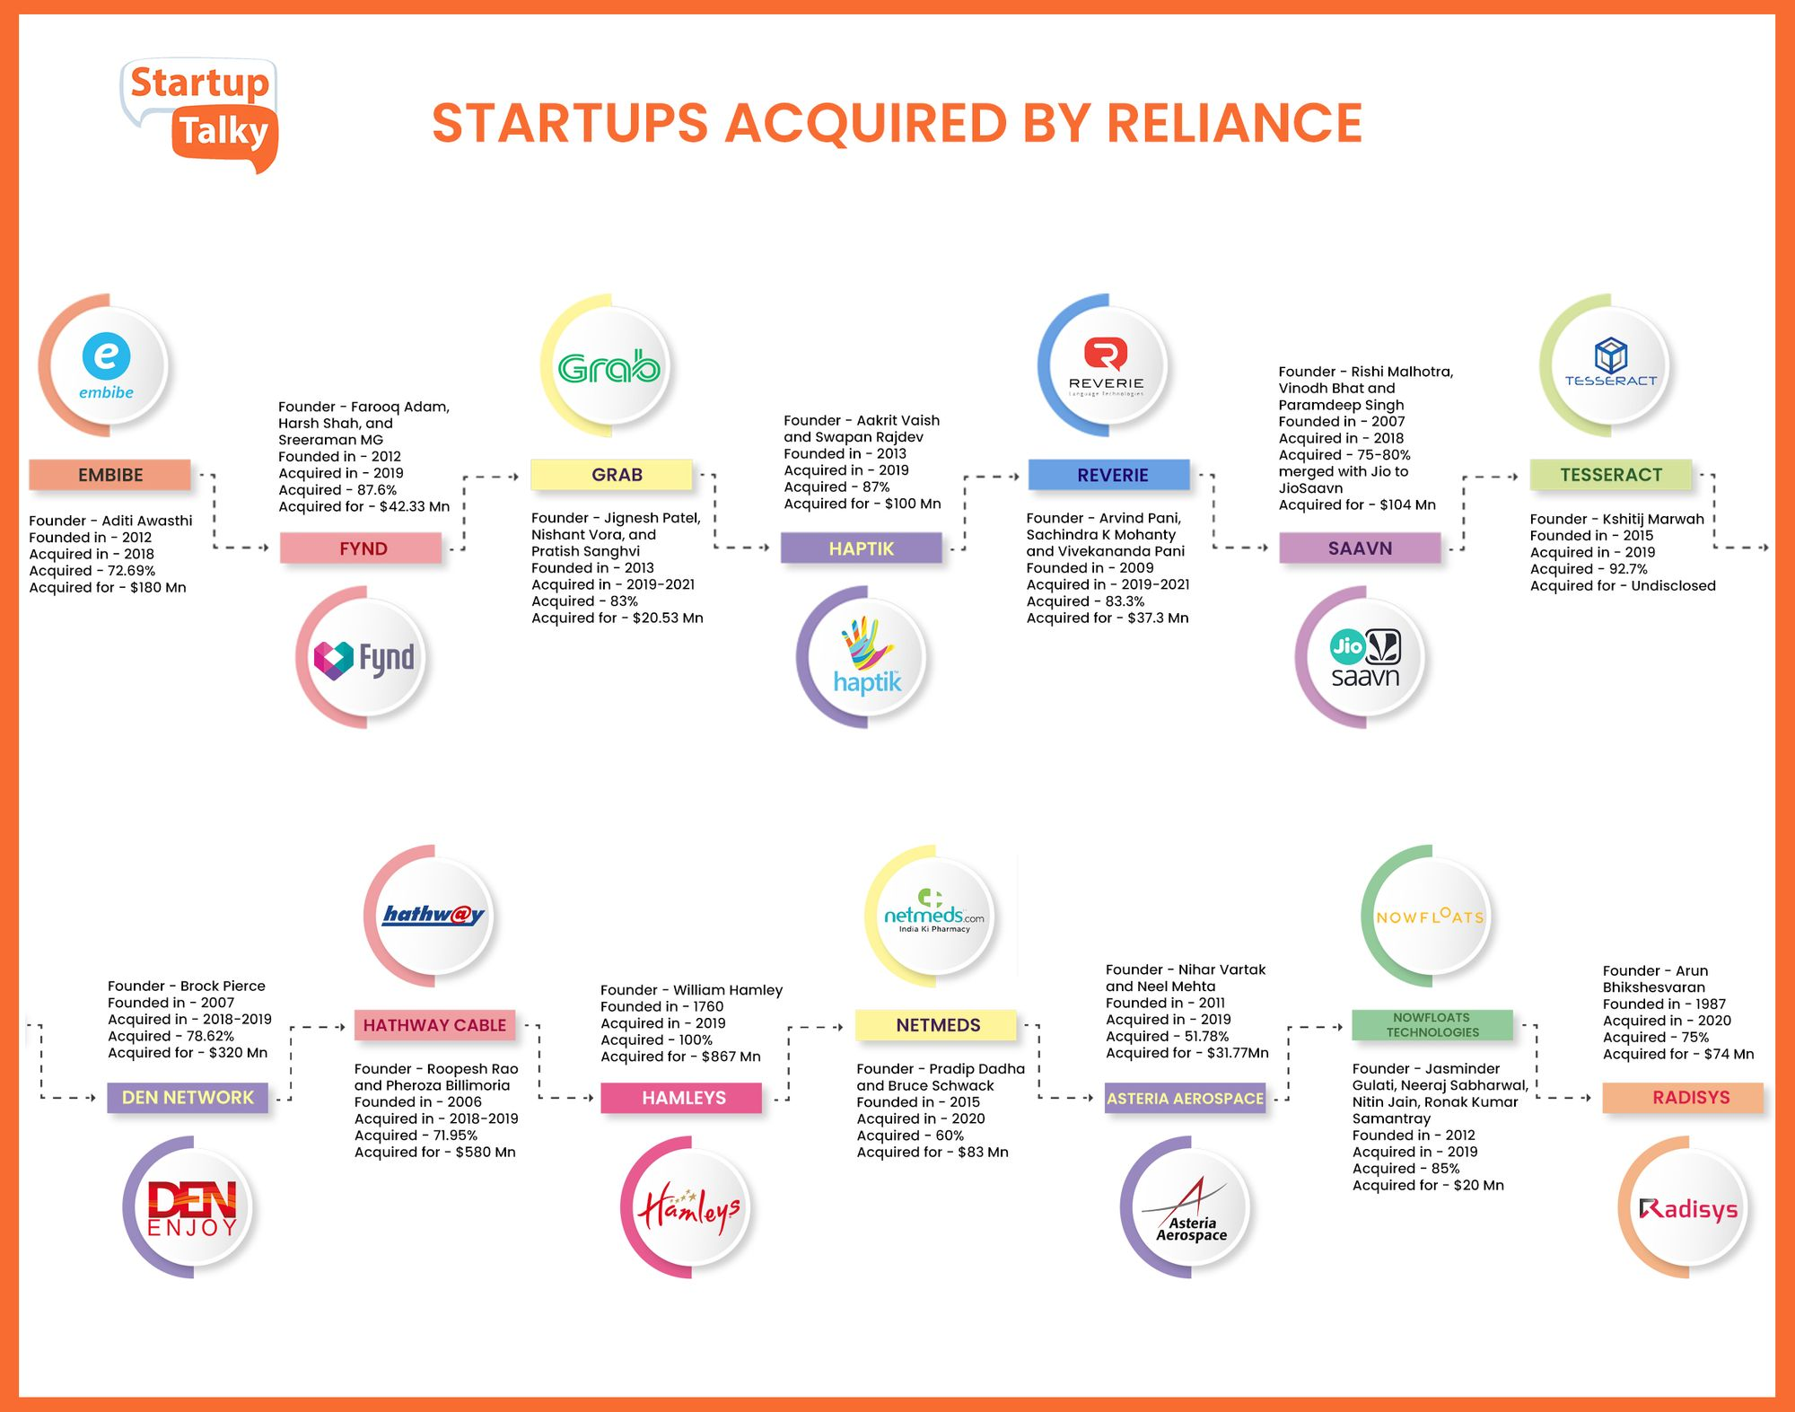
Companies acquired by Reliance Industry
EMBIBE
FYND
HAPTIK
RIVERIE
SAAVN
TESSERACT
HEMLEYS
DEN NETWORK
HATHWAY CABLE
RADISYS
NETMEDS
EROS INTERNATIONAL

Slide 5
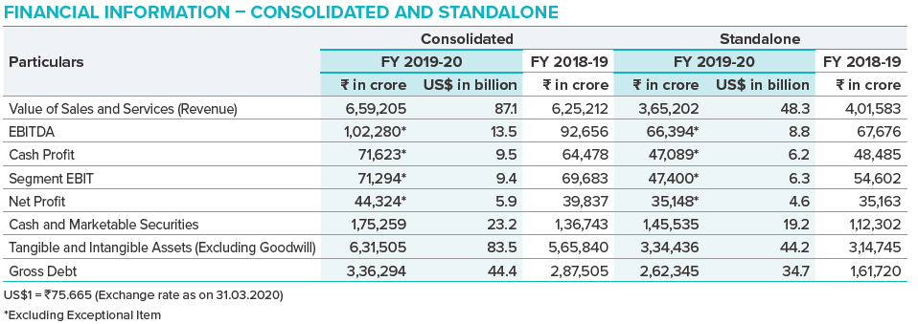
Financial Analysis and Reports of Previous Year
Reliance is focussed on optimising shareholder return by maintaining an optimum capital structure, liability profile and leverage ratio. The current low interest rate environment will enable Reliance to optimise on its interest cost. All its businesses generate strong operating cashflows. This year, our annual EBITDA crossed the `1,00,000 crore mark for the first time. Our consumer businesses recorded a robust growth on all operating and financial parameters and they now contribute to 35% of our consolidated segment EBITDA. Investments in the form of cash and cash equivalents has served as a liquidity buffer against macro shock and volatility. With a strong emphasis on risk management, the Company continues to secure its cash-flow and earnings risks. Reliance retained its domestic credit ratings of AAA from CRISIL, CARE and ICRA and investment grade rating for its international debt from Moody’s as Baa2 and BBB+ from S&P. The ratings are a testimony to Reliance’s strong balance sheet and the reliable growth trajectory of its business earnings.
Since its inception, Reliance has been a profit making enterprise with a focus on creating wealth for its investors. Above is the snapshot of Reliance’s financial performance.

Slide 6
Balanced Sheet Analysis
(Rs in crores)
Components | FY20(in Rs.) | FY19(in Rs.) | Remarks
Total Non Current Assets | 8,02,315 | 6,22,881 | Capital work in progress has decreased almost 80% but rest all components under this have a significant increase resulting in a huge 29% increase in total non current assets.
Total Current assets | 1,66,597 | 1,52,864 | Components like Inventories, trade receivable, other financial assets and other current assets had a dip while other 4 components had marginally increased resulting in around 10% increase in total current assets.
Total Assets | 9,68,912 | 7,75,745 | There is almost 25% increase in total assets from FY19 to FY20.
Total Non Current Liabilities | 2,34,145 | 1,68,402 | Other Financial liabilities has added to FY20 not there in FY19 most of components have increased showing almost 37% increase in this.
Total Current Liabilities | 3,10,183 | 2,02,021 | In this, other financial liabilities became almost 5 time the previous one and a few components had dip but of very small margin therefore overall more than 50% increase is there
Total Liabilities | 5,44,328 | 3,70,423 | 47% Increase from FY19 to FY20.
Total Equity | 4,24,584 | 4,05,322 | Equity share capital remain unchanged while other equity had a minor increase resulting a small increase of around 5% is there.

Slide 7
Cash Flow Statement Analysis
(Rs in crores)
Components | FY20(in Rs.) | FY19(in Rs.) | Remarks
Cash Flow from Operating Activities | 76,560 | 29,191 | We can see a huge increment of 162% on Y-o-Y basis in value of CFO from FY19 to FY20.
Cash Flow from Investing Activities | 1,42,652 | 53,949 | CFI stood at almost 3 times the previous year value on Y-o-Y basis as most of its components have increased significantly over the year also one component wasn’t there in FY19 and in FY20 it has a value over 31k crores.
Cash Flow from Financing Activities | 70,767 | 25,795 | This contains information of cash involved in all the financing activities over the year almost all factors had increment in their value over the year resulting in a huge increment of nearly 45k crores in CFF
Net Increase in Cash and Cash Equivalents | 4,675 | 1,037 | This year like all component this too increased heavily and becomes more than 4 times of FY19.
Opening Balance of Cash and Cash Equivalents | 3,768 | 2,731 | This is the value of Cash and Cash Equivalent at the start of year.
Closing Balance of Cash and Cash Equivalents | 8,443 | 3,768 | This is the final value of CCE at the end of year this we get from adding net increase in cash and cash equivalents to opening balance of cash and cash equivalent

Slide 8
Profit and Loss Statement Analysis
(Rs in crores)
Components | FY20(in Rs.) | FY19(in Rs.) | Remarks
Total Income | 6,25,601 | 5,91,480 | All the components under this category have increased resulting in a mere increase in the total income in FY20 from FY19.
Total Expenses | 5,67,658 | 5,36,356 | Only cost of material consumed have decreased over the year but rest all factors had increment in their value following 5.7% increase in total expenses.
Profit Before Exceptional Items and Tax | 58,050 | 55,227 | This quantity we get from subtracting total expenses from total income and then adding share of profit to the result after this subtraction. This share of profit just increased by 4 crores from FY19 to FY20.
Profit before Tax | 53,606 | 55,227 | This quantity we got from removing cost of exceptional items from the above quantity. In FY19 there was no exceptional cost thus showing no effect.
Profit for the Year | 39,880 | 39,837 | This is the net profit of company for a year after removing all deferred and current taxes and here we can see there is very less increase in profit for the year it’s a mere increase of 43 crores from FY19 to FY20.
Total Compensation Income of the Year | 55,173 | 98,602 | This is summation of profit of the year to other compensation income we can see that profit of the year increase over the year FY19 to FY20 but there is huge decrement in compensation income resulting in the huge dip in this component.

Slide 9
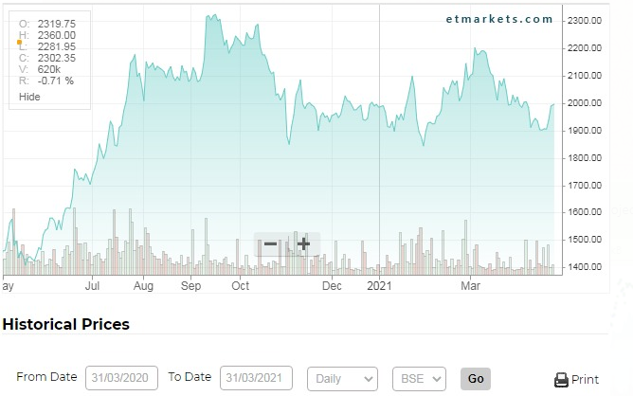
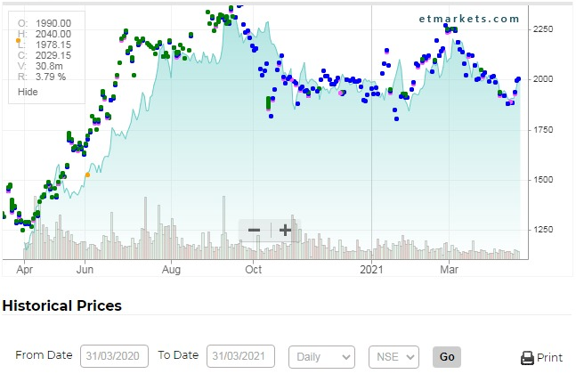
Stock Market Price Fluctuations
BSE Historical Prices Fluctuations of Reliance Industries
NSE Historical Prices Fluctuations of Reliance Industries
Reliance shares have grown handsomely during the pandemic against all odds. Mukesh Ambani, the chairman of RIL, has been on a mission to expand the conglomerate from its traditional energy and oil business.
According to data compiled by Bloomberg, RIL accounted for nearly a fifth of the 75 per cent surge in the S&P BSE Sensex since March. That is literally double the contribution of Apple Inc has made to gains in the S&P 500 index over the same period.
Market experts said Reliance’s recent fundraising drive has sharply increased its stock market valuation. They expect RIL's valuation to further rise next year, indicating that the company's stockholders are in a sweet spot at the moment.

Slide 10
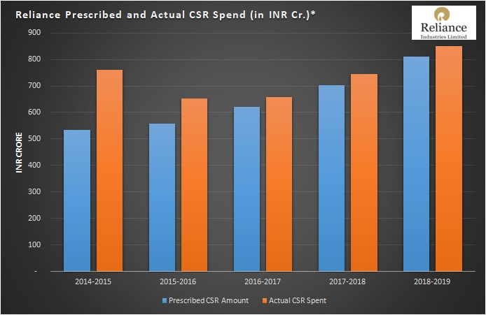
Reliance Industries CSR Report
RIL has impacted the society and community through its responsible actions, at large. In alignment with the Companies Act 2013, RIL established the Reliance Foundation RF. This foundation takes care of corporate social initiatives of RIL. RF is a committed player in improving the quality of life of the underprivileged by zeroing in on different focus areas – education, disaster response, sports for development, rural transformation, arts culture and heritage and urban renewal.
Reliance Industries CSR Report
In the financial year 2016-17, the RF spent INR 659.20 crores of INR 620.41 crores prescribed. Following that year in 2017-18, the Reliance Foundation spent INR 745.04 crores of the expected INR 703.08 crores. And in the year 2018-19, the RF spent INR 849.32 crores on CSR activities, out of the INR 811.16 crores prescribed on initiatives of RIL.
Reliance Industries Limited spent Rs. 1,022 crores on CSR (Corporate Social Responsibility) programmes and projects during the financial year (FY) 2019-20. Total CSR spending includes Rs 228.80 crore towards contribution to Reliance Foundation Institution of Education Research (RFIER), as Corpus for the proposed University project. Expenditure of Rs 500 crore on Disaster Relief includes contribution to PM CARES Fund and Rs. 56 crores to other various relief funds.
Fig. The Graph shows the CSR Budget vs. CSR spend by RIL Ltd in the last five years

Slide 11
Reliance Foundation CSR Activities
Skilling and Employment: India faces a major issue in employing its young population. The Skill India Mission of the Government of India has asked the corporates for support in training the youth of India by making them employable. Reliance has answered the clarion call and has leveraged its infrastructure and trained workforce to provide marketable skillsets and placement support to the youth. More than 9,400 youth were linked to various employment opportunities.
Education: Reliance Industries CSR works closely on educational activities with educational institutions all over the country. They aim to provide better quality education, scholarships, sports development and access to higher education. Few of their projects are Dhirubhai Ambani Scholarship Programme, Reliance Dhirubhai Ambani Protsaham Scheme, Jio Schools and Young Champs Programme.
Health Care: Reliance Foundation has set up static and mobile medical and healthcare units across Maharashtra, Madhya Pradesh Uttarakhand, Gujarat, Uttar Pradesh and Andhra Pradesh. They have eight fully-functioning and equipped mobile medical units and four static medical units. Other medical and health care projects and initiatives are Women’s Health Care, Dhirubhai Ambani Hospital, Drishti and Mission Zero Malnourishment Project.
Reliance CSR in the fight against Corona virus: RIL CSR has deployed the combined strengths of Reliance Foundation, Reliance Retail, Jio, Reliance Life Sciences, Reliance Industries, and its 6,00,000 strong Reliance family to work together to help India fight this COVID19 pandemic. They have taken various steps that have created a blueprint that can be imitated at a rapid pace to create infrastructure and facilities needed to take India on the other side of this Coronavirus pandemic. Let us look at a few of the steps: Reliance Industries Chairman in a philanthropic move donated 100 tones of oxygen to the hospitals of the state(MH), for free. RIL is using its production facilities to produce 100,000 face-masks per day and a large number of personal protective equipment’s (PPEs), such as suits and garments, for the nation’s health workers. Reliance Foundation Hospital, in collaboration with the Brihanmumbai Municipal Corporation (BMC), has created a first-of-its-kind-in-India covid centre which is fully funded by Reliance Foundation They have provided beds that are equipped with the required infrastructure, biomedical equipment such as ventilators, pacemakers, dialysis machines, and patient monitoring devices.

Slide 12
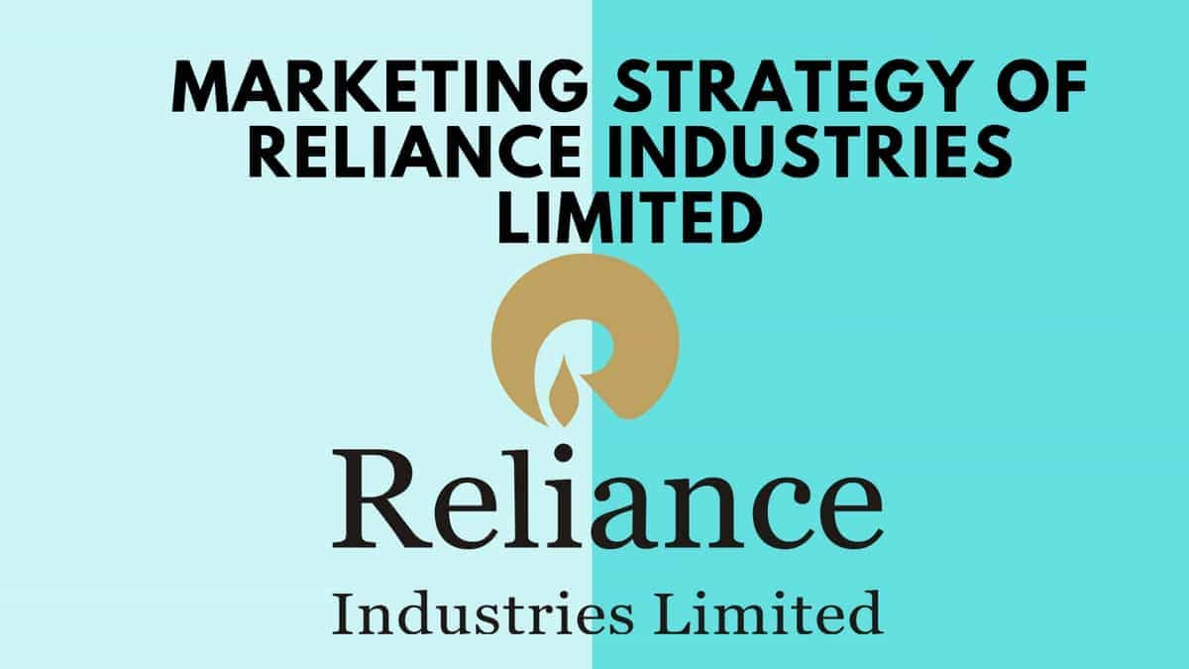
Reliance Industries’ Marketing Strategies
RIL applies selective, differentiated and aggressive pricing strategies to capture its target market. It uses a mix of variables like geography, demography and psychography like age, gender, profession, income class, region, behavior.
Marketing mix of RIL that comprises of the 4P’s like Place, price, products and promotion explains the marketing strategy of the Company.
As for the “products” RIL has launched a diversified range of products starting from petrochemicals to retail business to health etc. As we all know that Reliance Industries recently became the first Indian company to cross 6 trillion market capitalization. They provide several products like in the retail sector are Reliance Fresh, Big Bazaar, Reliance Mart, Reliance Market, Reliance Home Kitchen, Reliance iStore.
As for the “price” the pricing policies of RIL is different for different products which is based on market leadership and competition of the products. Reliance Industries follows different pricing strategy for different sectors. When the company launched Reliance Jio, it offered free Jio services to its customers during the launch period to increase market share.
As for “place”, the Company has a strong presence all across the country. Reliance Retail is the largest retailer that has more than 1500 stores across India and other brands like Reliance Fresh, Reliance Footprint, Reliance Digital and Reliance Trends have reached the Tier 1 and Tier 2 cities. Reliance Jio sim services are available across major regions and its connectivity is also improved in recent months. Reliance fresh procures raw materials directly from the source hence it has attracted large number of customers due to the discounts offered.
As for “promotion”, the Company believes in customer satisfaction through price reduction of the products as an effective way of promoting its products. The company adopted the aggressive and selective pricing policing strategy; and focuses on the market analysis. With the help of Jio the telecom brand of Reliance, the company tries to digitalize India. Jio offered free Wi-Fi services for several cities of India. The company has a customer like the high-class citizen who lives in metros to lower middle class who live in rural India.
One of the main parts of their marketing strategy is the Promotional strategy. They spend a lesser amount for their campaigns, but they reduce the product prices what help them to attract more customer from all across the nation.

Slide 13
How COVID-19 affected Reliance Industries
The major impact was seen in RIL’s petrochemicals and oil refining businesses.
Reliance Industries reported a 15 per cent year-on-year drop in consolidated net profit for the July-September quarter as the COVID-19 pandemic hit its key petrochemicals and oil refining businesses. Petrochemical revenue was down 23 per cent from a year ago to Rs 29,665 crore, refining revenue fell 36 per cent to Rs 62,154 crore.
The company’s revenue from operations stood at Rs 116,195 crore, down 24 per cent from the year ago revenue of Rs 153,384 crore.
Retail revenue declined 5 per cent year-on-year to Rs 39,199 crore.
This decline was partially offset by its telecom unit Jio; digital services revenue rose 36 per cent from a year ago to Rs 22,679 crores. Reliance Jio’s customer base touched 405.6 million at the end of September 2020, making it the only telecom operator outside China to have reached the milestone of 400 million subscribers in a single country market.

Slide 14
CONCLUSION
Reliance Industries is an amazing company having exceptional leadership and excellent management system. RIL is the first Indian private sector company to feature into the Fortune Global 500. With leading market position in many of its businesses, Reliance is a business giant in India with strong positions in Textile, energy, Retail etc. Reliance upholds their corporate social responsibilities very well. Reliance has strong marketing strategies due to which it has strong presence in the market.

Slide 15
THANK YOU
Presentation by:
Ashish Kumar - (2K18/SE/041)
Gaurav Kumar - (2K18/SE/060)

